Slide 1
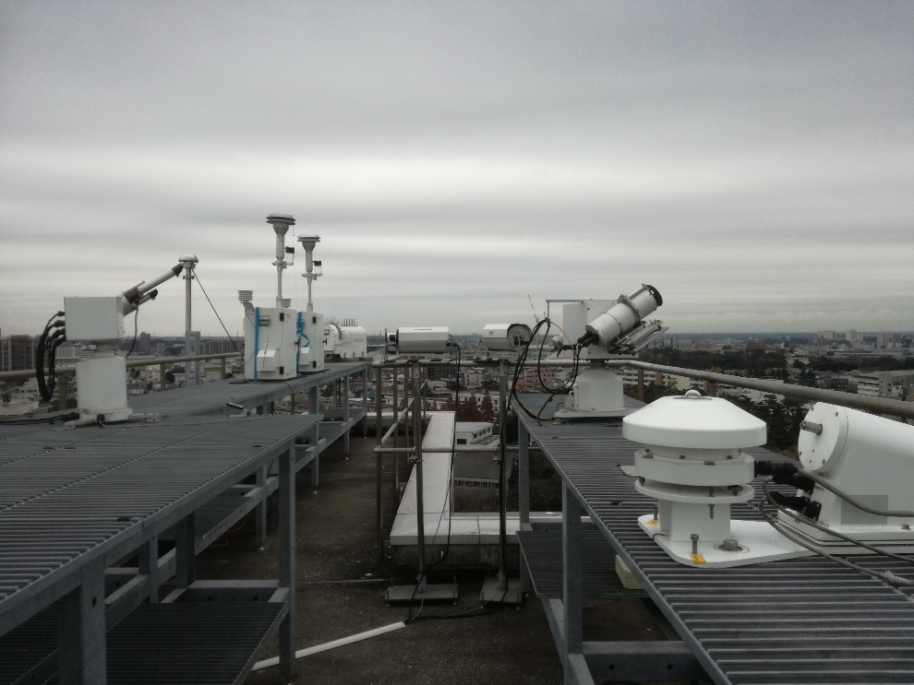
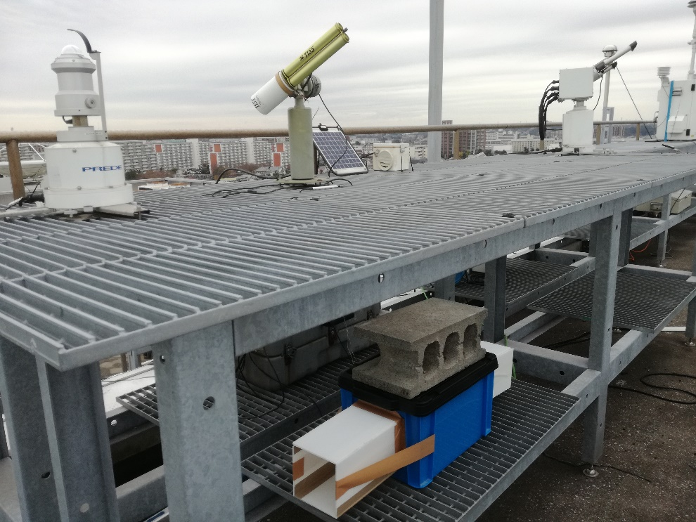
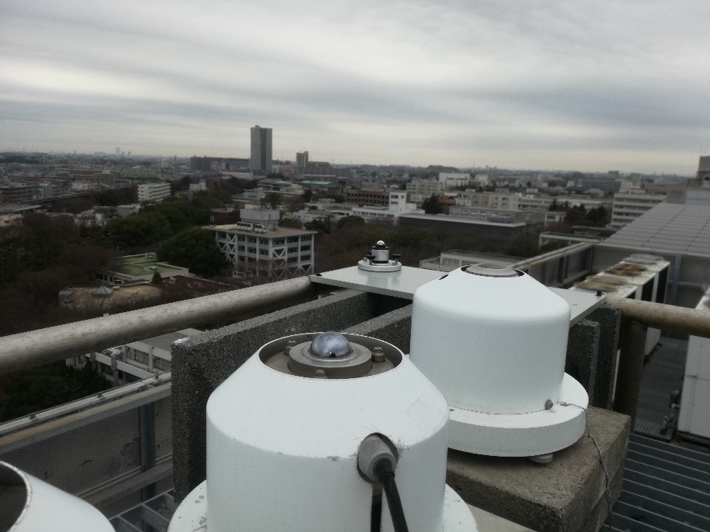
Today’s photo of the site

Slide 2
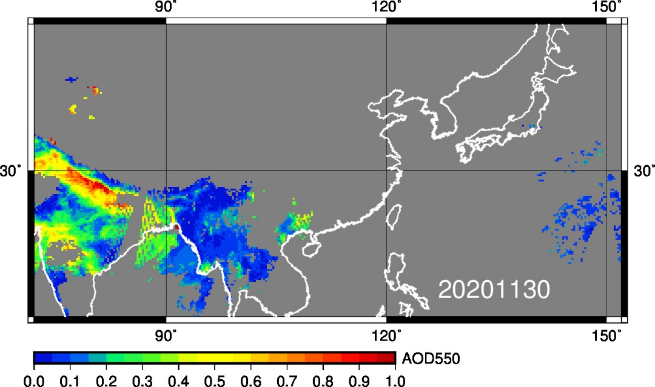
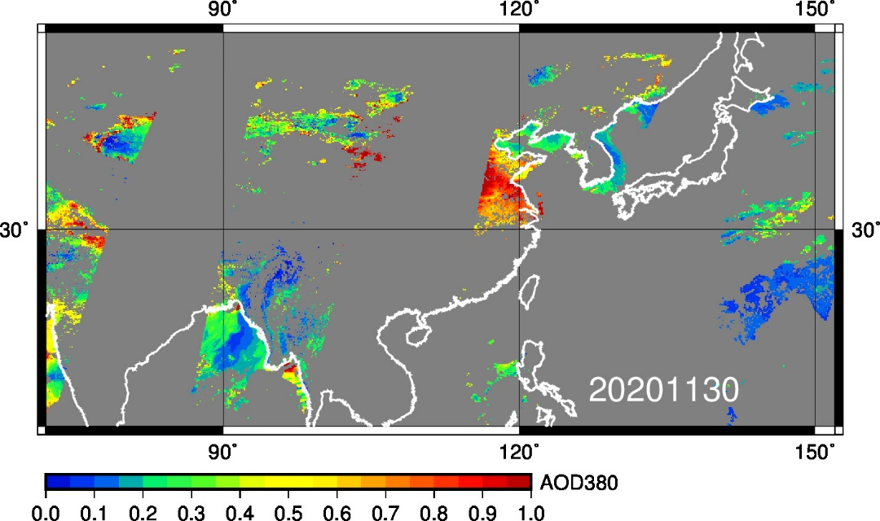
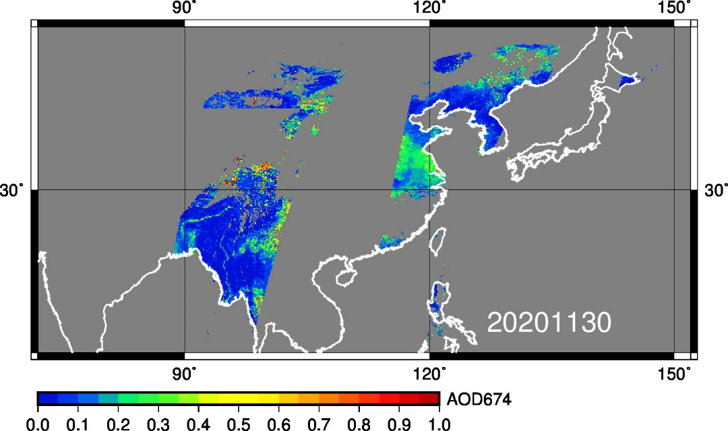
MODIS and GCOM-C/SGLI AOT (20201130)
MODIS
(550 nm)
GCOM-C/SGLI
(380 nm)
GCOM-C/SGLI
(674 nm)

